Slide 1
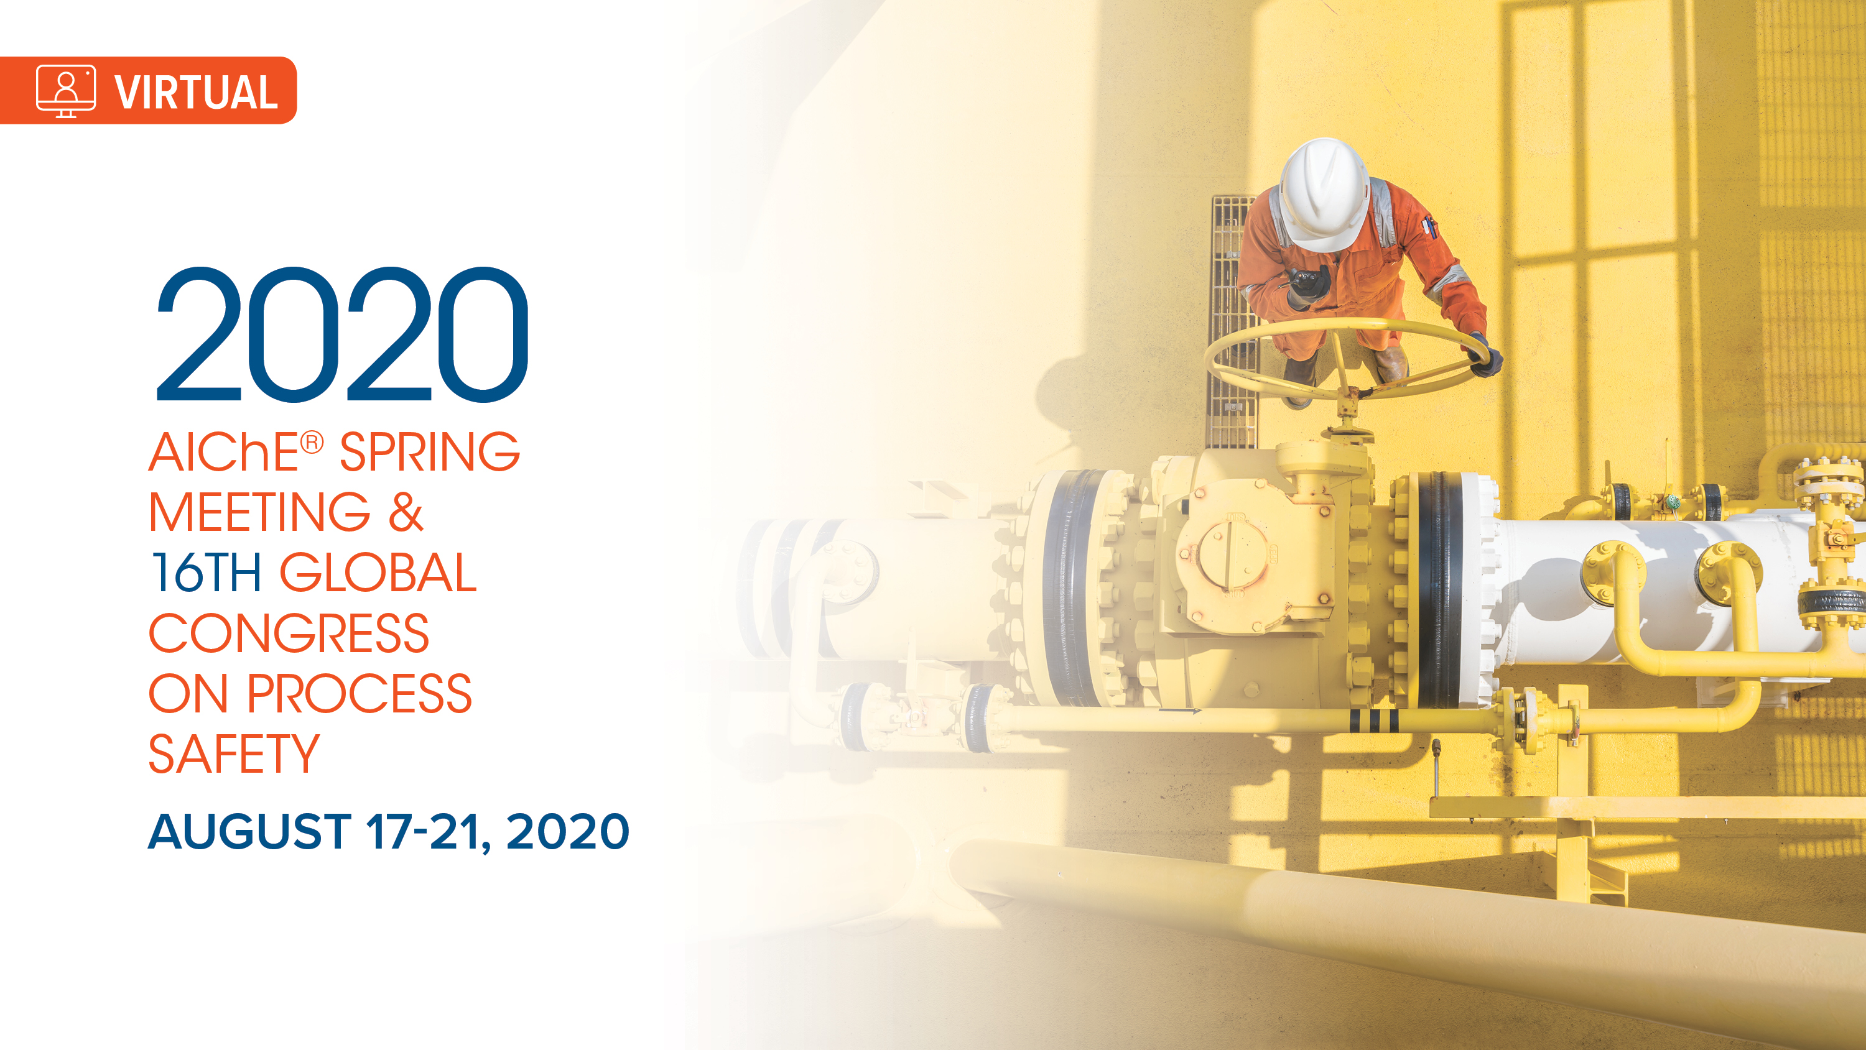

Slide 2
Making sure Initiating Events and
Independent Protection Layers are included in
Integrated Management Systems
William Bridges
Paul Casarez

Slide 3
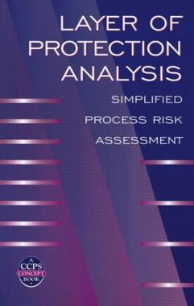

William Bridges
Process Improvement Institute - President
STUDIES
BS & MS Chemical Engineering
Co-invented LOPA
Certified functional safety professional
Process safety expert
Human factors expert
EXPERIENCE
+40 years
13 years in plant, 2 as Operator
+250 Unit PHAs
+8000 PHAs managed
+1000 LOPAs
+1000 SIL Verification/Assessments
+3500 trained PHA/LOPA leaders
PUBLICATIONS
Main author of
5 other CCPS Guidelines books – contributing author
+50 Papers presented

Slide 4
IPL RULES
INDEPENDENT | CAPABLE
MAINTAINED | PROVEN/ AUDITED

Slide 5
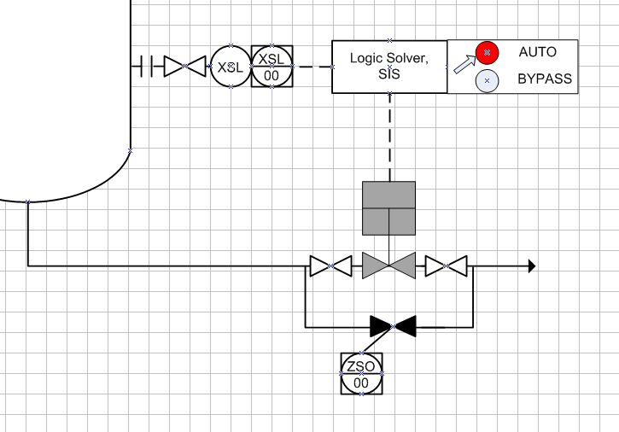
NUANCE - IPL BOUNDARY
Boundary A: Instrumented components only
(most SIL verifications use this boundary)

Slide 6
NUANCE - IPL BOUNDARY
Boundary A: Instrumented components only
(most SIL verifications use this boundary)
Boundary B: Complete IPL
(includes root valves and bypasses)

Slide 7
Approach for managing IEs and IPLs
1. |  | 2.
Identify IEs and IPLs |  | Extracting IEs and IPLs
3. |  | 4.
Implementing the ITPM and/or Operating procedures/training/ drills of each IE and IPL |  | Proof testing & Auditing protocol to ensure proper care of each IE and IPL

Slide 8
Approach for managing IEs and IPLs
1. |  | 2.
Identify IEs and IPLs |  | Extracting IEs and IPLs
3. |  | 4.
Implementing the ITPM of each IE and IPL |  | Auditing protocol to ensure proper care of each IE and IPL

Slide 9
The PHA team leader must understand fully the rules and definitions for IPLs and IEs and be competent in application of them.

Slide 10



PHA USERS
Engineering |  | MI |  | Operations/Training
Identifying the IPLs needed (including SIFs) Identifying the target SIL (if SIF used) Finding the limiting case for PSV sizing Determining fire protection needs Facility siting Error proofing designs |  | List of IEs and IPLs (all safety critical equipment) Unique corrosion/erosion issues Bypassing plans and time limits (and therefore critical spares) SCE that may require staggering maintenance |  | List of Human IEs and Human IPLs (all safety critical actions) Alarm rationalization (all safety critical alarms) Provides Input to Trouble-shooting Guides (the procedures for responding to critical deviations) Remote isolations and emergency response Error reduction needs

Slide 11
PHA USERS
Engineering |  | MI |  | Operations/Training
Identifying the IPLs needed (including SIFs) Identifying the target SIL (if SIF used) Finding the limiting case for PSV sizing Determining fire protection needs Facility siting Error proofing designs |  | List of IEs and IPLs (all safety critical equipment) Unique corrosion/erosion issues Bypassing plans and time limits (and therefore critical spares) SCE that may require staggering maintenance |  | List of Human IEs and Human IPLs (all safety critical actions) Alarm rationalization (all safety critical alarms) Provides Input to Trouble-shooting Guides (the procedures for responding to critical deviations) Remote isolations and emergency response Error reduction needs
IEs and IPLs

Slide 12
Each IE and IPL (mechanical and human related) are clearly shown in the PHA report
No.: 2 XXXX storage spheres xxx-T-XX A/B/C/D/E/F/G/H/I/J/K/L (1 of 12)
# | Dev. | Causes | Consequences | Safeguards | Recs
2.1 | High level | Too much flow to one sphere from XX Plant (through their pump; about 40 bar MDH) IEF Type: Mech IEF = 0.1/yr | High pressure (see 2.5) | High level SIF with level sensors voted 2oo2, to close inlet valve IPL Type: SIL 1 PFD = 0.1 Overflow thru normally open pressure equalization line to other spheres IPL Type: Process Vent PFD = 0.01
 |  | Misdirected flow - Liquid from xxx Plant(s) to spheres (see 1.4) | Overpressure of sphere not credible from high level, for normal operating pressure of the column (which is 1.75 MPa), unless all spheres are liquid filled and then thermal expansion of the liquid could overpressure the spheres | High level SIF with level sensors voted 2oo2, to close inlet valve IPL Type: SIL 1 PFD = 0.1 Overflow thru normally open pressure equalization line to other spheres IPL Type: Process Vent PFD = 0.01 Level indication and high level alarm in DCS, used by operators to manually select which tank to fill Type: BPCS PFD = 0.1
 |  |  | Excessive pressure on inlet of high-pressure liquid pumps, leading to excess load on pumps and trip of pumps on high pressure, causing trips of xxx, xxx, etc. - significant operability issue
2.2 | Low level | Failing to switch from the sphere with low level in time (based on level indication) IEF Type: Hum IEF = 0.01/yr | Low/no flow - Liquid from spheres through high pressure product pumps to the vaporizer (see 4.2) | Level indication and low level alarm, inspected each year, per government regulation (not IPL; part of the cause) Feeding from two spheres at all times, so unlikely for BOTH spheres to have low level at the same time (not IPL; part of the cause) Two level indication from SIS level transmitter, with low level alarm, with more than 60 min available to switch tanks (SIF driven alarm and response) - possible IPL, if operator action quick enough | Rec 4. Make sure the Human IPL of response to low level in all spheres and tanks is described in a trouble-shooting guide (like an SOP) and practiced once per year per unit operator. This will make this response a valid IPL.
 |  |  | Low/no flow - Unqualified liquid from spheres back to Plant (see 6.2)

Slide 13
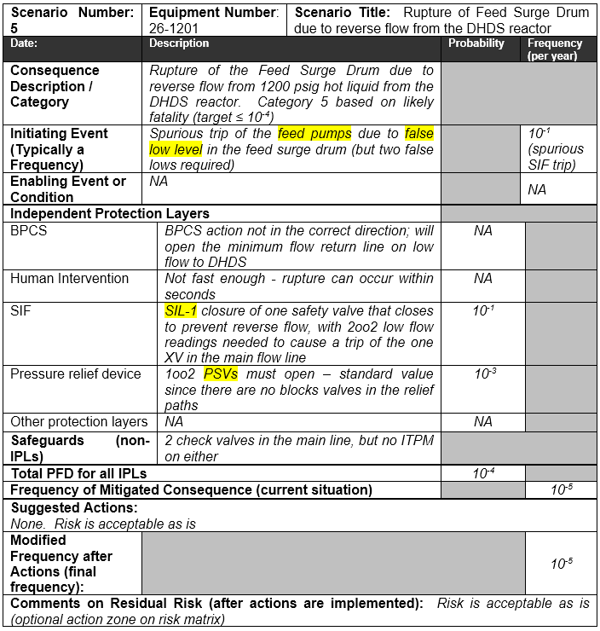
Each IE and IPL (mechanical and human related) are clearly shown in the LOPA worksheets

Slide 14
Approach for managing IEs and IPLs
1. |  | 2.
Identify IEs and IPLs |  | Extracting IEs and IPLs
3. |  | 4.
Implementing the ITPM of each IE and IPL |  | Auditing protocol to ensure proper care of each IE and IPL

Slide 15
Extracting IEs and IPLs
 | How to extract the IE and IPL data from the PHA and LOPA depends on the native software used
 |  | For Word or Excel outputs, the IE text, IEF Type, target IEFs, IPL text, IPL type, and PFD must be manually extracted
 |  | For LEADER™ software (ABS Consulting) it is possible to use the standard queries for PHA worksheets such as HAZOP or What-if to get all of the information in the proper format
 | Associate each item with the PHA deviation or the LOPA worksheet
 | Associate each item with the PFD, P&ID, and/or Operating Procedure
 | Include a full component tag number or step number and operating procedure number

Slide 16
Each IE and IPL (mechanical and human related) are extracted from the PHA report and included in ITPM Plan and/or Operation’s Training plan
No.: 2 XXXX storage spheres xxx-T-XX A/B/C/D/E/F/G/H/I/J/K/L (1 of 12)
# | Dev. | Causes | Consequences | Safeguards | Recs
2.1 | High level | Too much flow to one sphere from XX Plant (through their pump; about 40 bar MDH) IEF Type: Mech IEF = 0.1/yr | High pressure (see 2.5) | High level SIF with level sensors voted 2oo2, to close inlet valve IPL Type: SIL 1 PFD = 0.1 Overflow thru normally open pressure equalization line to other spheres IPL Type: Process Vent PFD = 0.01
 |  | Misdirected flow - Liquid from xxx Plant(s) to spheres (see 1.4) | Overpressure of sphere not credible from high level, for normal operating pressure of the column (which is 1.75 MPa), unless all spheres are liquid filled and then thermal expansion of the liquid could overpressure the spheres | High level SIF with level sensors voted 2oo2, to close inlet valve IPL Type: SIL 1 PFD = 0.1 Overflow thru normally open pressure equalization line to other spheres IPL Type: Process Vent PFD = 0.01 Level indication and high level alarm in DCS, used by operators to manually select which tank to fill Type: BPCS PFD = 0.1
 |  |  | Excessive pressure on inlet of high-pressure liquid pumps, leading to excess load on pumps and trip of pumps on high pressure, causing trips of xxx, xxx, etc. - significant operability issue
2.2 | Low level | Failing to switch from the sphere with low level in time (based on level indication) IEF Type: Hum IEF = 0.01/yr | Low/no flow - Liquid from spheres through high pressure product pumps to the vaporizer (see 4.2) | Level indication and low level alarm, inspected each year, per government regulation (not IPL; part of the cause) Feeding from two spheres at all times, so unlikely for BOTH spheres to have low level at the same time (not IPL; part of the cause) Two level indication from SIS level transmitter, with low level alarm, with more than 60 min available to switch tanks (SIF driven alarm and response) - possible IPL, if operator action quick enough | Rec 4. Make sure the Human IPL of response to low level in all spheres and tanks is described in a trouble-shooting guide (like an SOP) and practiced once per year per unit operator. This will make this response a valid IPL.
 |  |  | Low/no flow - Unqualified liquid from spheres back to Plant (see 6.2)

Slide 17
Each IE and IPL (mechanical and human related) are extracted from the LOPA worksheets and included in ITPM Plan and/or Operation’s Training plan

Slide 18
Approach for managing IEs and IPLs
1. |  | 2.
Identify IEs and IPLs |  | Extracting IEs and IPLs
3. |  | 4.
Implementing the ITPM and/or Operating procedures/training/ drills of each IE and IPL |  | Auditing protocol to ensure proper care of each IE and IPL

Slide 19
ITPM tasks and frequencies must be chosen and/or operating procedure & training & drills selected, and over time perhaps adjusted, in order to achieve the stated IEF for each IE and the PFD for each IPL
 | Any cause that is The IE must be inspected and maintained proactively and proven to provide the stated IEF (many companies are not conscious of this need)
 | Each required IPL must be properly maintained and proven to provide the PFD claimed by the company

Slide 20
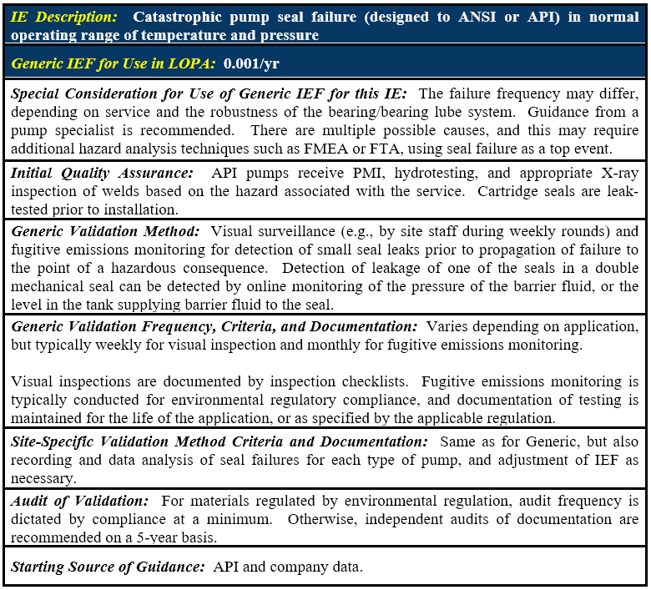

Slide 21
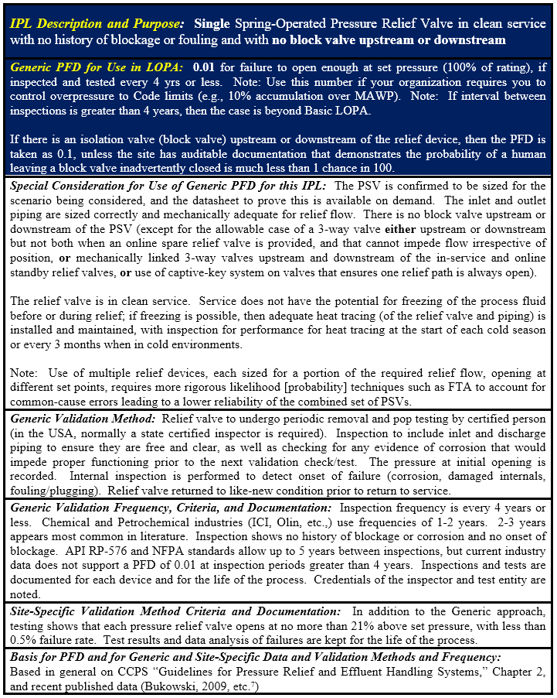

Slide 22
Approach for managing IEs and IPLs
1. |  | 2.
Identify IEs and IPLs |  | Extracting IEs and IPLs
3. |  | 4.
Implementing the ITPM of each IE and IPL |  | Proof testing & Auditing protocol to ensure proper care of each IE and IPL

Slide 23
Proving / Auditing IEs & IPLs:
First, check that IEs and IPLs have been captured by extracting several dozen causes and safeguards from the worksheets of a PHA
Then, make sure these are in the list of Safety Critical Equipment or Safety Critical Actions
Make sure that the site is performing ITPM and/or drills of each of these components or actions
Finally, check the failure rate of each to see if the target IEF or PFD is achieved

Slide 24
Select a Unit
Take the PHA of the Unit
Identify 3 to 6 High Consequence scenarios
List Causes and Safeguards of each
Take a Cause/Safeguard
Equipment-based items
Human action-based items
Check ITPM/Schedule
Documented evidence
Last Cause/Safeguard?
Last Cause/Safeguard?
END
Notes:
This is not exactly the same process that’s mentioned in the paper

Slide 25
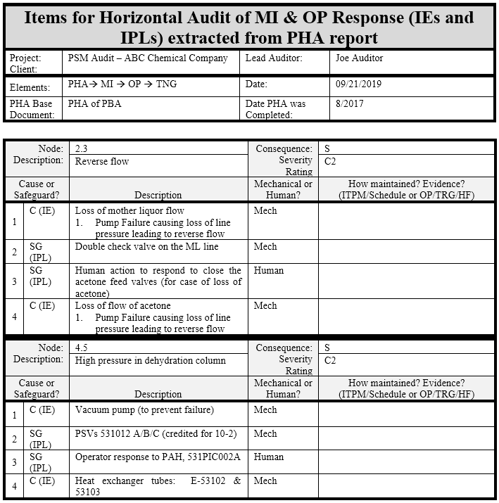

Slide 26
CLOSING:
Doing:
Risk assessments such as PHA/HAZOP and LOPA
And having a mechanical integrity or reliability program
And/or for human responses or causes, having procedures, training, and drills
are worthless unless the identified IEs and IPLs truly provide the risk reduction stated/needed
Making sure the targeted reliability factors are achieved requires proactive steps to ensure each IE and IPL is covered in the ITPM program and/or operations training program, proven in use, and audited

Slide 27

THANK YOU
WILLIAM (Bill)
BRIDGES
wbridges@piii.com

